Slide 1
Transformers - I
Lecture 8
Part 3
Generative AI for Computer Vision

Slide 2
Content
Spatial Context in Vision
Image Caption with Context Modelling
Attention for Image Caption

Slide 3
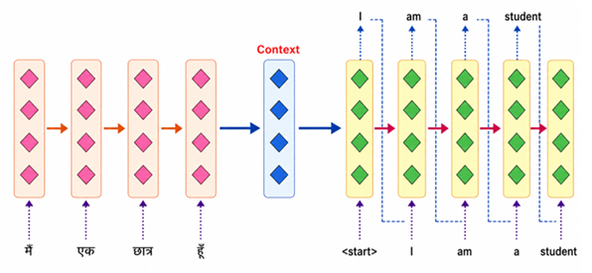
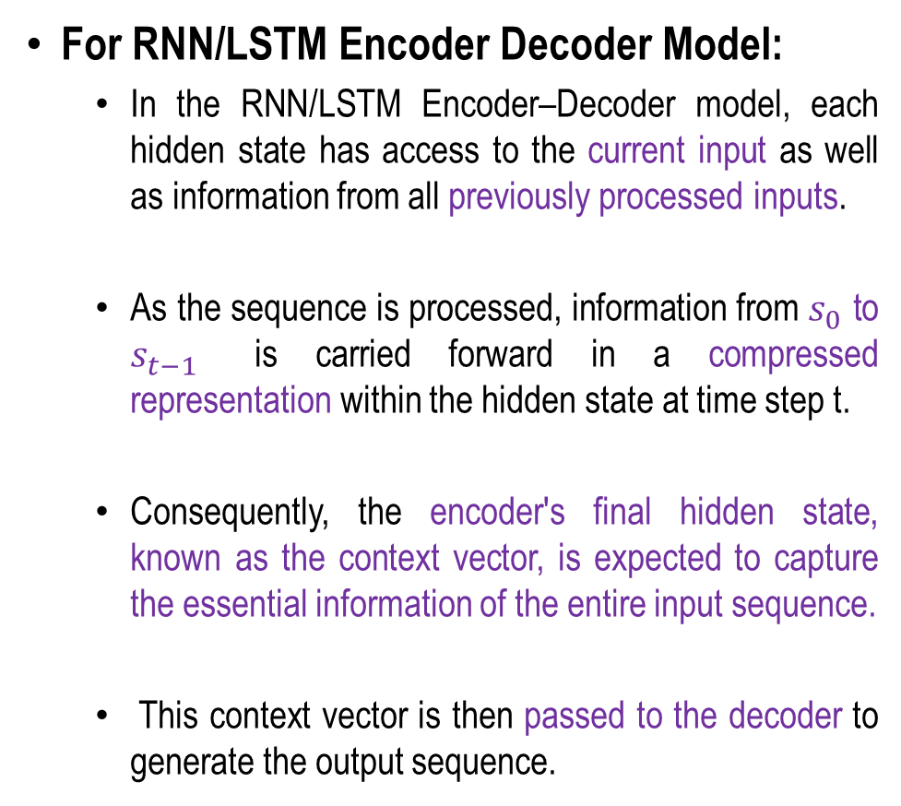
Sequence 2 Sequence Model using RNN/LSTM
For RNN/LSTM Encoder Decoder Model:
  In the RNN/LSTM Encoder–Decoder model, each hidden state has access to the current input as well as information from all previously processed inputs.
  As the sequence is processed, information from $s_{0}$ to $s_{t−1}$​ is carried forward in a compressed representation within the hidden state at time step t.
  Consequently, the encoder's final hidden state, known as the context vector, is expected to capture the essential information of the entire input sequence.
  This context vector is then passed to the decoder to generate the output sequence.
s₀
s₁
…
s_{t-1}

Slide 4
Image Captioning Using RNN with Spatial
Context Modelling
Image captioning combines computer vision and natural language processing to generate a textual description of an image.
In an RNN-based approach, a CNN first extracts visual features from the image, while spatial context modelling preserves information about where objects and regions are located.
Consequently, the encoder's final hidden state, known as the context vector, is expected to capture the essential information of the entire input image.
This context vector is then passed to the decoder to generate the output sequence.

Slide 5

Image Captioning with RNNs and Spatial Context
Extract spatial features from a pretrained CNN
CNN
Features:
H x W x D
Z_{0,0}
Z_{0,1}
Z_{0,2}
In image captioning problem,
Input is an Image (I)
A CNN is used to extract the important features for the image.
The output is a sequence of words describing the image briefly.
Z_{1,0}
Z_{1,1}
Z_{1,2}
Z_{2,0}
Z_{2,1}
Z_{2,2}
Xu et al, “Show, Attend and Tell: Neural Image Captain Generation with Visual Attention”, ICML 2015
Concept: Fei-Fei Li Attention and Transformers CS231n Stanford Lecture

Slide 6
Image Captioning with RNNs and Spatial Context
Extract spatial features from a pretrained CNN
CNN
Features:
H x W x D
Z_{0,0}
Z_{0,1}
Z_{0,2}
In image captioning problem,
Input is an Image (I)
A CNN is used to extract the important features for the image.
The output is a sequence of words describing the image briefly.
A MLP is used to extract the spatial context.
Z_{1,0}
Z_{1,1}
Z_{1,2}
Z_{2,0}
Z_{2,1}
Z_{2,2}
MLP
h₀
Xu et al, “Show, Attend and Tell: Neural Image Captain Generation with Visual Attention”, ICML 2015
Concept: Fei-Fei Li Attention and Transformers CS231n Stanford Lecture

Slide 7
Image Captioning with RNNs and Spatial Context
Extract spatial features from a pretrained CNN
CNN
Features:
H x W x D
Z_{0,0}
Z_{0,1}
Z_{0,2}
In image captioning problem,
In Decoder side, the RNN is employed.
[start] and Context vector (C) are the inputs for first decoder node.
Output of the 1st node is “Boy”
Z_{1,0}
Z_{1,1}
Z_{1,2}
Z_{2,0}
Z_{2,1}
Z_{2,2}
h₀
c
h₁
y₁
Boy
[START]
y₀
Xu et al, “Show, Attend and Tell: Neural Image Captain Generation with Visual Attention”, ICML 2015
Concept: Fei-Fei Li Attention and Transformers CS231n Stanford Lecture

Slide 8
Image Captioning with RNNs and Spatial Context
Extract spatial features from a pretrained CNN
CNN
Features:
H x W x D
Z_{0,0}
Z_{0,1}
Z_{0,2}
In image captioning problem,
Output of the 1st node is “Boy”
Output of the 1st decoder node comes
as the input of 2nd decoder node.
The context is also an input to 2nd node.
Output of the 2nd decoder node is
“weaving”.
Z_{1,0}
Z_{1,1}
Z_{1,2}
Z_{2,0}
Z_{2,1}
Z_{2,2}
h₀
c
[START]
h₁
y₁
Boy
y₀
h₂
y₂
waving
Boy
y₁
Xu et al, “Show, Attend and Tell: Neural Image Captain Generation with Visual Attention”, ICML 2015
Concept: Fei-Fei Li Attention and Transformers CS231n Stanford Lecture

Slide 9
Image Captioning with RNNs and Spatial Context
Extract spatial features from a pretrained CNN
CNN
Features:
H x W x D
Z_{0,0}
Z_{0,1}
Z_{0,2}
In image captioning problem,
Output of the 2nd decoder node is “weaving”.
Output of the 2nd decoder node comes
as the input of 3rd decoder node.
The context is also an input to 3rd node.
Output of the 3rd decoder node is “flag”
Z_{1,0}
Z_{1,1}
Z_{1,2}
Z_{2,0}
Z_{2,1}
Z_{2,2}
h₀
c
[START]
h₁
y₁
Boy
y₀
h₂
y₂
waving
Boy
y₁
h₃
y₃
flag
waving
y₂
Xu et al, “Show, Attend and Tell: Neural Image Captain Generation with Visual Attention”, ICML 2015
Concept: Fei-Fei Li Attention and Transformers CS231n Stanford Lecture

Slide 10
Image Captioning with RNNs and Spatial Context
Extract spatial features from a pretrained CNN
CNN
Features:
H x W x D
Z_{0,0}
Z_{0,1}
Z_{0,2}
In image captioning problem,
Finally,
Output of the 3rd decoder node comes
as the input of the 4th decoder node.
The context is also an input to 4th node.
Output of the 4th decoder node is “[END]”
The Process stops.
Z_{1,0}
Z_{1,1}
Z_{1,2}
Z_{2,0}
Z_{2,1}
Z_{2,2}
h₀
c
[START]
h₁
y₁
Boy
y₀
y₁
h₂
y₂
waving
Boy
h₃
y₃
flag
waving
y₂
flag
y₃
h₄
y₄
[END]
Xu et al, “Show, Attend and Tell: Neural Image Captain Generation with Visual Attention”, ICML 2015
Concept: Fei-Fei Li Attention and Transformers CS231n Stanford Lecture

Slide 11
Problems with this approach
Extract spatial features from a pretrained CNN
CNN
The RNN/LSTM Encoder–Decoder model encodes the meaning of the whole image into a fixed-length context vector before passing it to the decoder.
This creates an information bottleneck, as all the relevant information must be encoded into a single vector. Consequently, the model struggles to handle long or complex input sequences, especially those longer than the sequences seen during training.
The limited capacity of the context vector can lead to the loss of important information. Furthermore, the decoder must generate the entire output sequence using only this single context vector, making it difficult to accurately recover all the information from the source sequence.
As a result, the model's performance often degrades for long sequences and complex translation tasks.
Features:
H x W x D
Z_{0,0}
Z_{0,1}
Z_{0,2}
Z_{1,0}
Z_{1,1}
Z_{1,2}
Z_{2,0}
Z_{2,1}
Z_{2,2}
information
bottleneck
h₀
c
[START]
h₁
y₁
Boy
y₀
y₁
h₂
y₂
waving
Boy
h₃
y₃
flag
waving
y₂
flag
y₃
h₄
y₄
[END]
Concept: Fei-Fei Li Attention and Transformers CS231n Stanford Lecture

Slide 12
Attention
Attention for context modelling is a mechanism that enables a neural network to dynamically identify and use the most relevant information from a set of inputs when producing an output.
Instead of treating all input elements equally, attention assigns a weight to each element based on its relevance to the current context.
In image captioning, for example, the model can focus on different spatial regions of an image depending on the word being generated.
At each time step, the previous hidden state of the RNN acts as a query to determine which image features are most relevant.
The weighted combination of these features forms a context vector, which is then used by the RNN to generate the next word.

Slide 13
How Attention Solves This?
The attention mechanism addresses these limitations by allowing the decoder to dynamically access all encoder hidden states rather than relying solely on a single context vector.
At each decoding step, attention calculates relevance scores for the encoder hidden states, converts these scores into normalized attention weights, and computes a weighted sum to generate a step-specific context vector.
Consequently, the decoder can focus on different location of the input image when generating different output tokens (as part of the caption).
This reduces the information bottleneck, improves the handling of long sequences and long-term dependencies, and enables the model to align relevant input and output elements more effectively.
Thus, attention transforms the fixed-context model into a more flexible model capable of selectively retrieving the information required for each decoding step.

Slide 14
Image Captioning with RNNs and Attention
Extract spatial features from a pretrained CNN
CNN
It enables the model to dynamically select relevant image regions for each generated word, improving the accuracy, interpretability, and contextual relevance of the generated caption.
Features:
H x W x D
Z_{0,0}
Z_{0,1}
Z_{0,2}
Z_{1,0}
Z_{1,1}
Z_{1,2}
Z_{2,0}
Z_{2,1}
Z_{2,2}
h₀
Xu et al, “Show, Attend and Tell: Neural Image Captain Generation with Visual Attention”, ICML 2015
Concept: Fei-Fei Li Attention and Transformers CS231n Stanford Lecture

Slide 15
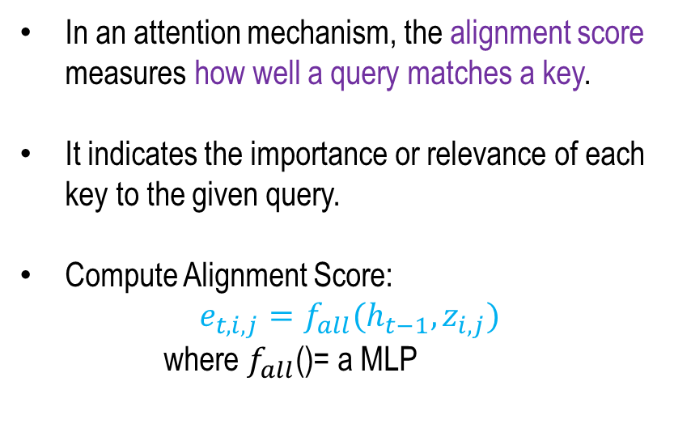
Image Captioning with RNNs and Attention
Computing Alignment Score
Extract spatial features from a pretrained CNN
In an attention mechanism, the alignment score measures how well a query matches a key.
It indicates the importance or relevance of each key to the given query.
Compute Alignment Score:
$$e_{t,i,j}=f_{all}(h_{t−1},z_{i,j})$$
where $f_{all}$()= a MLP
CNN
e_{1,0,0}
e_{1,0,1}
e_{1,0,2}
Z_{0,0}
Z_{0,1}
Z_{0,2}
e_{1,1,0}
e_{1,1,1}
e_{1,1,2}
Alignment Scores:
H x W
Features:
H x W x D
Z_{1,0}
Z_{1,1}
Z_{1,2}
e_{1,2,0}
e_{1,2,1}
e_{1,2,2}
Z_{2,0}
Z_{2,1}
Z_{2,2}
h₀
Xu et al, “Show, Attend and Tell: Neural Image Captain Generation with Visual Attention”, ICML 2015
Concept: Fei-Fei Li Attention and Transformers CS231n Stanford Lecture

Slide 16
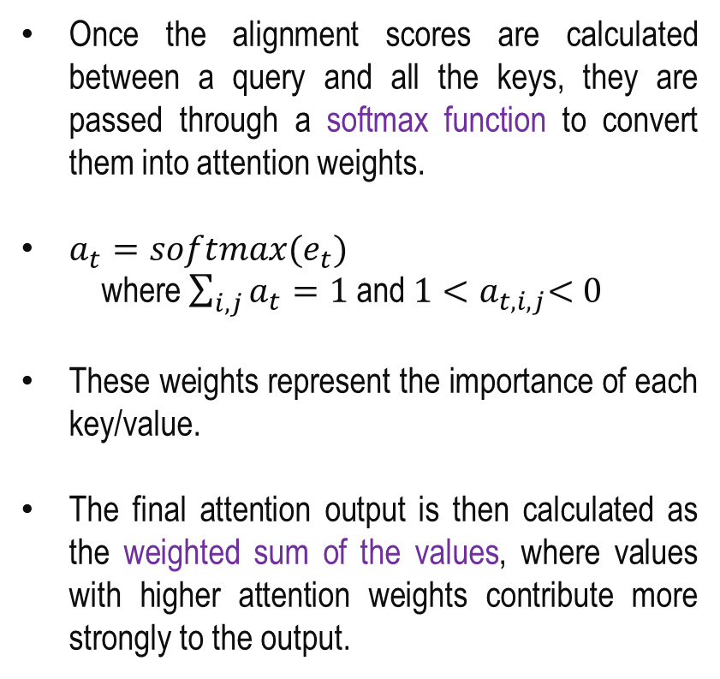
Image Captioning with RNNs and Attention
Computing Attention
Extract spatial features from a pretrained CNN
Once the alignment scores are calculated between a query and all the keys, they are passed through a softmax function to convert them into attention weights.
$a_{t}=softmax(e_{t})$
where $\sum_{i,j}{a_{t}=1}$ and $1{<a}_{t,i,j}<0$
These weights represent the importance of each key/value.
The final attention output is then calculated as the weighted sum of the values, where values with higher attention weights contribute more strongly to the output.
CNN
e_{1,0,0}
e_{1,0,1}
e_{1,0,2}
Z_{0,0}
Z_{0,1}
Z_{0,2}
e_{1,1,0}
e_{1,1,1}
e_{1,1,2}
Alignment Scores:
H x W
Features:
H x W x D
Z_{1,0}
Z_{1,1}
Z_{1,2}
e_{1,2,0}
e_{1,2,1}
e_{1,2,2}
Z_{2,0}
Z_{2,1}
Z_{2,2}
a_{1,0,0}
a_{1,0,1}
a_{1,0,2}
a_{1,1,0}
a_{1,1,1}
a_{1,1,2}
Attention:
H x W
a_{1,2,0}
a_{1,2,1}
a_{1,2,2}
h₀
Xu et al, “Show, Attend and Tell: Neural Image Captain Generation with Visual Attention”, ICML 2015
Concept: Fei-Fei Li Attention and Transformers CS231n Stanford Lecture

Slide 17
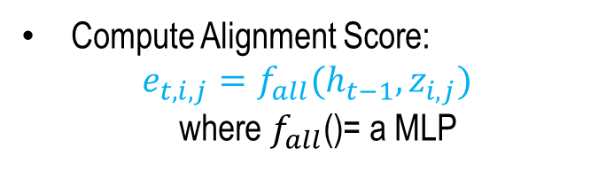

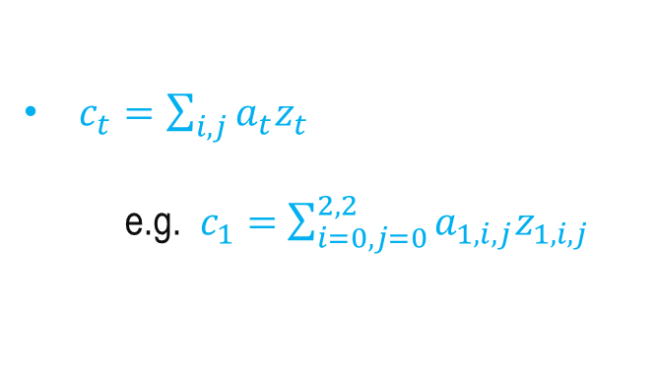
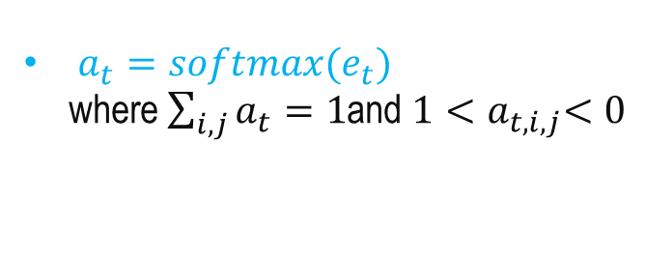
Image Captioning with RNNs and Attention
Computing Context Vector ($c_{1}$) at Time Step 1
Extract spatial features from a pretrained CNN
Compute Alignment Score:
$$e_{t,i,j}=f_{all}(h_{t−1},z_{i,j})$$
where $f_{all}$()= a MLP
CNN
e_{1,0,0}
e_{1,0,1}
e_{1,0,2}
Z_{0,0}
Z_{0,1}
Z_{0,2}
e_{1,1,0}
e_{1,1,1}
e_{1,1,2}
Alignment Scores:
H x W
$a_{t}=softmax(e_{t})$
where $\sum_{i,j}{a_{t}=1}$and $1{<a}_{t,i,j}<0$
Features:
H x W x D
Z_{1,0}
Z_{1,1}
Z_{1,2}
e_{1,2,0}
e_{1,2,1}
e_{1,2,2}
Z_{2,0}
Z_{2,1}
Z_{2,2}
a_{1,0,0}
a_{1,0,1}
a_{1,0,2}
$c_{t}=\sum_{i,j}{a_{t}z_{t}}$
e.g. $c_{1}=$ $\sum_{i=0,j=0}^{2,2}{a_{1,i,j}z_{1,i,j}}$
a_{1,1,0}
a_{1,1,1}
a_{1,1,2}
Attention:
H x W
a_{1,2,0}
a_{1,2,1}
a_{1,2,2}
h₀
c₁
Xu et al, “Show, Attend and Tell: Neural Image Captain Generation with Visual Attention”, ICML 2015
Concept: Fei-Fei Li Attention and Transformers CS231n Stanford Lecture

Slide 18
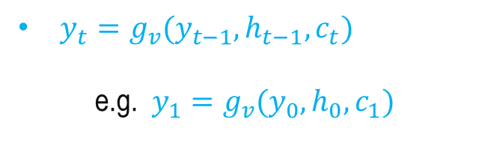
Image Captioning with RNNs and Attention
Computing Output at first time-step
Extract spatial features from a pretrained CNN
Compute Alignment Score:
$$e_{t,i,j}=f_{all}(h_{t−1},z_{i,j})$$
where $f_{all}$()= a MLP
CNN
$a_{t}=softmax(e_{t})$
where $\sum_{i,j}{a_{t}=1}$and $1{<a}_{t,i,j}<0$
Features:
H x W x D
Z_{0,0}
Z_{0,1}
Z_{0,2}
Z_{1,0}
Z_{1,1}
Z_{1,2}
Z_{2,0}
Z_{2,1}
Z_{2,2}
At each decoder node (time step), the model uses the different context vector looking at the different parts of the image.
$c_{t}=\sum_{i,j}{a_{t}z_{t}}$
e.g. $c_{1}=$ $\sum_{i=0,j=0}^{2,2}{a_{1,i,j}z_{1,i,j}}$
h₀
$y_{t}=g_{v}(y_{t−1},h_{t−1},c_{t})$
e.g. $y_{1}=g_{v}(y_{0},h_{0},c_{1})$
c₁
[START]
h₁
y₁
Boy
y₀
Xu et al, “Show, Attend and Tell: Neural Image Captain Generation with Visual Attention”, ICML 2015
Concept: Fei-Fei Li Attention and Transformers CS231n Stanford Lecture

Slide 19
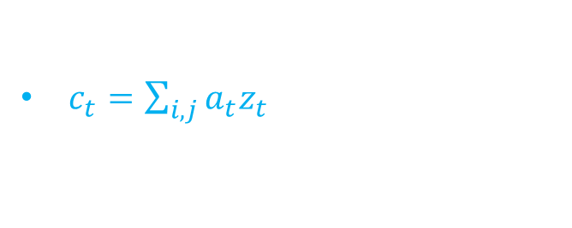
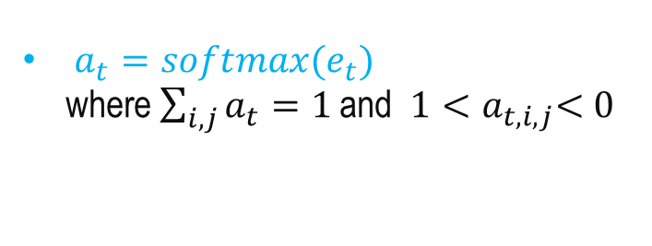

Image Captioning with RNNs and Attention
Computing Context Vector ($c_{2}$) at Time Step 2
Extract spatial features from a pretrained CNN
Compute Alignment Score:
$$e_{t,i,j}=f_{all}(h_{t−1},z_{i,j})$$
where $f_{all}$()= a MLP
CNN
e_{1,0,0}
e_{1,0,1}
e_{1,0,2}
Z_{0,0}
Z_{0,1}
Z_{0,2}
e_{1,1,0}
e_{1,1,1}
e_{1,1,2}
Alignment Scores:
H x W
$a_{t}=softmax(e_{t})$
where $\sum_{i,j}{a_{t}=1}$and $1{<a}_{t,i,j}<0$
Features:
H x W x D
Z_{1,0}
Z_{1,1}
Z_{1,2}
e_{1,2,0}
e_{1,2,1}
e_{1,2,2}
Z_{2,0}
Z_{2,1}
Z_{2,2}
a_{1,0,0}
a_{1,0,1}
a_{1,0,2}
$c_{t}=\sum_{i,j}{a_{t}z_{t}}$
a_{1,1,0}
a_{1,1,1}
a_{1,1,2}
Attention:
H x W
a_{1,2,0}
a_{1,2,1}
a_{1,2,2}
h₀
[START]
c₁
h₁
y₁
Boy
y₀
c₂
Xu et al, “Show, Attend and Tell: Neural Image Captain Generation with Visual Attention”, ICML 2015
Concept: Fei-Fei Li Attention and Transformers CS231n Stanford Lecture

Slide 20
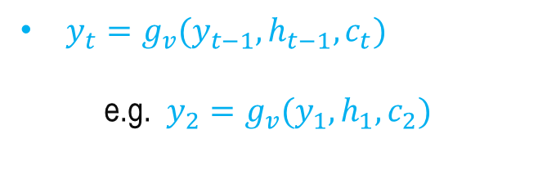
Image Captioning with RNNs and Attention
Computing Output at second time-step
Extract spatial features from a pretrained CNN
Compute Alignment Score:
$$e_{t,i,j}=f_{all}(h_{t−1},z_{i,j})$$
where $f_{all}$()= a MLP
CNN
$a_{t}=softmax(e_{t})$
where $\sum_{i,j}{a_{t}=1}$and $1{<a}_{t,i,j}<0$
Z_{0,0}
Z_{0,1}
Z_{0,2}
Features:
H x W x D
Z_{1,0}
Z_{1,1}
Z_{1,2}
At each decoder node (time step), the model uses the different context vector looking at the different parts of the image.
Z_{2,0}
Z_{2,1}
Z_{2,2}
$c_{t}=\sum_{i,j}{a_{t}z_{t}}$
h₀
$y_{t}=g_{v}(y_{t−1},h_{t−1},c_{t})$
e.g. $y_{2}=g_{v}(y_{1},h_{1},c_{2})$
[START]
c₁
h₁
y₁
Boy
y₀
Boy
c₂
h₂
y₂
waving
y₁
Xu et al, “Show, Attend and Tell: Neural Image Captain Generation with Visual Attention”, ICML 2015
Concept: Fei-Fei Li Attention and Transformers CS231n Stanford Lecture

Slide 21
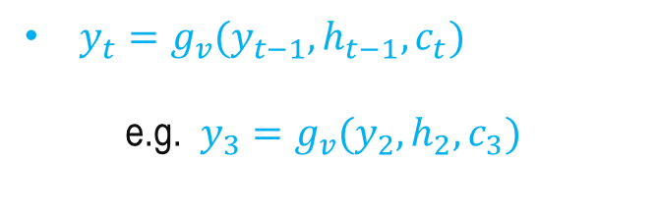
Image Captioning with RNNs and Attention
Computing Output at third time-step
Extract spatial features from a pretrained CNN
Compute Alignment Score:
$$e_{t,i,j}=f_{all}(h_{t−1},z_{i,j})$$
where $f_{all}$()= a MLP
CNN
$a_{t}=softmax(e_{t})$
where $\sum_{i,j}{a_{t}=1}$and $1{<a}_{t,i,j}<0$
Features:
H x W x D
Z_{0,0}
Z_{0,1}
Z_{0,2}
Z_{1,0}
Z_{1,1}
Z_{1,2}
Z_{2,0}
Z_{2,1}
Z_{2,2}
At each decoder node (time step), the model uses the different context vector looking at the different parts of the image.
$c_{t}=\sum_{i,j}{a_{t}z_{t}}$
h₀
$y_{t}=g_{v}(y_{t−1},h_{t−1},c_{t})$
e.g. $y_{3}=g_{v}(y_{2},h_{2},c_{3})$
[START]
c₁
h₁
y₁
Boy
y₀
Boy
c₂
h₂
y₂
waving
y₁
waving
c₃
Concept: Fei-Fei Li Attention and Transformers CS231n Stanford Lecture
h₃
y₃
flag
Xu et al, “Show, Attend and Tell: Neural Image Captain Generation with Visual Attention”, ICML 2015
y₂

Slide 22
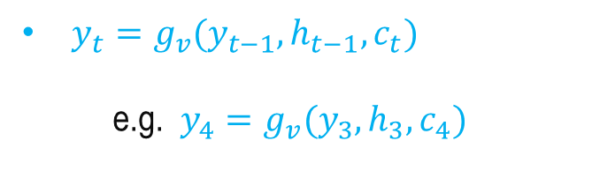
Image Captioning with RNNs and Attention
Computing Output at final time-step
Extract spatial features from a pretrained CNN
CNN
Compute Alignment Score:
$$e_{t,i,j}=f_{all}(h_{t−1},z_{i,j})$$
where $f_{all}$()= a MLP
Features:
H x W x D
Z_{0,0}
Z_{0,1}
Z_{0,2}
Z_{1,0}
Z_{1,1}
Z_{1,2}
Z_{2,0}
Z_{2,1}
Z_{2,2}
$a_{t}=softmax(e_{t})$
where $\sum_{i,j}{a_{t}=1}$and $1{<a}_{t,i,j}<0$
h₀
$c_{t}=\sum_{i,j}{a_{t}z_{t}}$
c₁
[START]
h₁
y₁
Boy
y₀
$y_{t}=g_{v}(y_{t−1},h_{t−1},c_{t})$
e.g. $y_{4}=g_{v}(y_{3},h_{3},c_{4})$
Boy
c₂
h₂
y₂
waving
y₁
waving
c₃
h₃
y₃
flag
y₂
flag
c₄
Concept: Fei-Fei Li Attention and Transformers CS231n Stanford Lecture
h₄
y₄
[END]
Xu et al, “Show, Attend and Tell: Neural Image Captain Generation with Visual Attention”, ICML 2015
y₃

Slide 23
Image Captioning with RNNs and Attention
Extract spatial features from a pretrained CNN
CNN
e_{1,0,0}
e_{1,0,1}
e_{1,0,2}
For example, for the image caption: “Boy weaving flag”
  The model may focus on the “Boy” region while generating “Boy”.
  It shifts the focus to the “flag” region while generating the word “flag” and so on.
Attention makes image captioning spatially aware.
It enables the model to dynamically select relevant image regions for each generated word, improving the accuracy, interpretability, and contextual relevance of the generated caption.
Z_{0,0}
Z_{0,1}
Z_{0,2}
e_{1,1,0}
e_{1,1,1}
e_{1,1,2}
Alignment Scores:
H x W
Features:
H x W x D
Z_{1,0}
Z_{1,1}
Z_{1,2}
e_{1,2,0}
e_{1,2,1}
e_{1,2,2}
Z_{2,0}
Z_{2,1}
Z_{2,2}
a_{1,0,0}
a_{1,0,1}
a_{1,0,2}
a_{1,1,0}
a_{1,1,1}
a_{1,1,2}
Attention:
H x W
h₀
a_{1,2,0}
a_{1,2,1}
a_{1,2,2}
[START]
c₁
h₁
y₁
Boy
y₀
Boy
c₂
h₂
y₂
waving
y₁
waving
c₃
h₃
y₃
flag
y₂
flag
c₄
Concept: Fei-Fei Li Attention and Transformers CS231n Stanford Lecture
h₄
y₄
[END]
Xu et al, “Show, Attend and Tell: Neural Image Captain Generation with Visual Attention”, ICML 2015
y₃

Slide 24
Summary
Spatial Context in Vision
Image Caption with Context Modelling
Attention for Image Caption

Slide 25
Transformers - II
Next
Lecture 8: Part 4
Generative AI for Computer Vision

